Slide 1
Unit 5 Document Object Model in JavaScript
Prepared by Amanpal Singh

Slide 2
Syllabus content
Document Object Model
Programming HTML DOM with JavaScript
Assigning event handlers in JavaScript using DOM object property
addeventlistener and removeeventlistener in JavaScript
Event bubbling in JavaScript
Image gallery with thumbnails in JavaScript

Slide 3

1. Document Object Model
Explain the DOM as a programming.
When a web page is loaded
the browser creates a DOM of the page.
It is a standard
object model &
programming interface for HTML
We can use JavaScript to access HTML elements.

Slide 4
2. Programming HTML DOM with JavaScript
JavaScript HTML DOM Document
Finding HTML Elements
Changing HTML Elements
Adding and Deleting Elements
Finding HTML Elements
Method | Description
document.getElementById(id) | Find an element by element id
document.getElementsByTagName(name) | Find elements by tag name
document.getElementsByClassName(name) | Find elements by class name

Slide 5
2.1.1 getElementById
Accessing Elements: document.getElementById('elementId’)
Show how to select a single element by its ID.
// HTML: <div id="myDiv">Hello</div>
const myDiv = document.getElementById('myDiv'); console.log(myDiv);
// Output: <div id="myDiv">Hello</div>

Slide 6
2.1.2 getElementsByTagName
document.getElementsByTagName('tagName'): Show selecting elements by their tag name (returns an HTMLCollection).
// HTML: <span>Span 1</span> <span>Span 2</span>
const mySpans = document.getElementsByTagName('span'); console.log(mySpans);
// Output: HTMLCollection [span, span]

Slide 7
Demonstration
<html> <body> <!-- not here-->
<span>Span 1 </span> <span>Span 2 <div id="myDiv">hii</div> </span>
<p> byeee </p> <p> hiiii </p> </body>
<script>
const mySpans = document.getElementsByTagName('span’);
console.log(mySpans); console.log(mySpans[1]);
</script>
</html>

Slide 8
HTML <span>
The HTML <span> tag is an inline container.
Used to group and apply styles or scripts to specific parts of text or elements.
While it doesn’t affect the layout or appearance on its own.
It serves as a target for CSS styling and JavaScript interactions.
<span class="">Some Text</span> <span class="">Some Text</span>

Slide 9
2.1.3 getElementsByClassName
document.getElementsByClassName('className’)
Demonstrate selecting multiple elements by class name
returns an HTMLCollection.
// HTML: <p class="myPara">Para 1</p> <p class="myPara">Para 2</p>
const myParas = document.getElementsByClassName('myPara'); console.log(myParas); // Output: HTMLCollection [p.myPara, p.myPara] console.log(myParas[0]) //Output: <p class="myPara">Para 1</p>

Slide 10
Demo
<html> <body>
<div class="a"> <p>This is a paragraph.</p> </div> <br>
<div class="b"> <p>This is a paragraph.</p> </div> <br>
<div class="b"> <p>This is a paragraph.</p> </div>
<script> const collection = document.getElementsByClassName("b");
collection[0].style.backgroundColor = "red"; </script>
</body>
</html>

Slide 11
Id vs class
The id attribute uniquely identifies a single element.
The class attribute can be applied to multiple elements.
Both are essential for CSS styling and JavaScript manipulation.

Slide 12
querySelector
document.querySelector('selector’)
Explain selecting a single element using CSS selectors (more powerful).
// HTML: <div id="parent"><p class="myPara">Hello</p></div>
const myPara = document.querySelector('#parent .myPara'); console.log(myPara);
// Output: <p class="myPara">Hello</p>

Slide 13
querySelectorAll
document.querySelectorAll('selector’):
Show how to select all elements that match the given CSS selector (returns a NodeList).
// HTML: <div class="items"> <li> item 1 </li> <li> item 2 </li> </div> <div class="items"> <li> item 3 </li> <li> item 4 </li></div>
const items = document.querySelectorAll('.items li'); console.log(items) // Output: NodeList(4) [li, li, li, li]

Slide 14
2.2 Accessing and manipulating DOM elements
Changing HTML Elements
Property | Description
element.innerHTML = new html content | Change the inner HTML of an element
element.attribute = new value | Change the attribute value of an HTML element
element.style.property = new style | Change the style of an HTML element
Method | Description
element.setAttribute(attribute, value) | Change the attribute value of an HTML element

Slide 15
2.2.1 getElementById
<html> <body>
<p id="px">Hello World!</p>
<script>
document.getElementById("px").innerHTML = "New text!";
</script>
</body> </html>

Slide 16
<html> <body>
<button id="myButton" onclick="myFunction()" color="RED">Try it</button>
<p id="demo"></p>
<script> function myFunction() {
let n = document.getElementById("myButton").attributes.length;
document.getElementById("demo").innerHTML = n;
}</script> </body> </html>

Slide 17
2.2.2 element.style.property
<html> <body>
<p id="xyz">Click "Change" to give me a red background color.</p>
<button onclick="myFunction()">Change</button>
<script>
function myFunction() {
document.getElementById("xyz").style.backgroundColor = "red";
} </script>
</body> </html>

Slide 18
2.2.3 element.setAttribute (attribute, value)
<html> <style> .democlass { color: red; } </style>
<body>
<h1 id="xx">The Element Object</h1>
<button onclick="myFunction()">Add Class</button>
<script> function myFunction() {
document.getElementById("xx").setAttribute("class", "democlass");
} </script>
</body> </html>

Slide 19
2.3 Adding and Deleting Elements
Method | Description
document.createElement(element) | Create an HTML element
document.removeChild(element) | Remove an HTML element
document.appendChild(element) | Add an HTML element
document.replaceChild(new, old) | Replace an HTML element
document.write(text) | Write into the HTML output stream

Slide 20
2.3.1 document.createElement(element)
<html> <body> <script>
const para = document.createElement("p"); para.innerText = "This is a paragraph.";
// Append to body:
document.body.appendChild(para);
</script>
</body> </html>

Slide 21
2.3.2 document.removeChild(element)
<html> <body> <button onclick="myFunction()">Remove</button>
<ul id="myList"> <li>Coffee</li> <li>Tea</li> <li>Milk</li> </ul>
<script>
function myFunction() {
const list = document.getElementById("myList");
list.removeChild(list.firstElementChild);
}
</script> </body> </html>

Slide 22
2.3.3 document.appendChild(element)
<html> <body> <button onclick="myFunction()">Add</button>
<ul id="myList"> <li>Coffee</li> <li>Tea</li> <li>Milk</li></ul>
<script>
function myFunction() {
const node = document.createElement("li"); // Create an "li" node:
const textnode = document.createTextNode("Water"); //// Create a text node:
node.appendChild(textnode); // Append the text node to the "li" node:
document.getElementById("myList").appendChild(node); // Append the "li" node to the list:
}
</script>
</body> </html>

Slide 23
2.3.4 document.replaceChild(new, old)
<html> <body> <button onclick="myFunction()">Remove</button>
<ul id="myList"> <li>Coffee</li> <li>Tea</li> <li>Milk</li> </ul>
<script> function myFunction() {
const element = document.getElementById("myList").children[0]; // Select first child element:
const newNode = document.createTextNode("Water"); // Create a new text node:
element.replaceChild(newNode, element.childNodes[0]); // Replace the text node:
}
</script>
</body> </html>

Slide 24
2.3.5 document.write(text)
<html> <body>
<script>
document.write("Hello World!");
</script>
</body> </html>

Slide 25
2.3.6 Dynamic styling and manipulation of elements
It is a powerful way to create interactive and engaging web applications.
Changing Styles Dynamically
<body class="light-mode"> <h1 id="myElement">Hello, World!</h1>
<script>// Select the element
const element = document.getElementById('myElement');
// Change styles
element.style.color = 'blue';
element.style.backgroundColor = 'yellow';
element.style.fontSize = '20px';
</script>
</body>

Slide 26
3. Event Handling in JavaScript
Events are actions or occurrences that happen in the browser,
such as clicking a button, moving the mouse, pressing a key, or submitting a form.
It refers to detecting these actions and defining what should happen in response.
Select an Element: Identify the HTML element where the event should occur.
Add an Event Listener: Use JavaScript to listen for specific events on that element.
Define a Callback Function: Write a function that will execute when the event is triggered.

Slide 27
3.1 Assigning event handlers in JavaScript using DOM object property
There are primarily three ways to assign event handlers to HTML elements:
1. HTML Event Attributes
2. DOM Properties
3. addEventListener() Method

Slide 28
3.1 HTML Event Attributes
<button onclick="myFunction()">Click me</button>
<script>
function myFunction() { alert('Button Clicked!'); }
</script>
Simple approach
Discouraged for maintainability reasons.
It mixes HTML structure with JavaScript logic.
Maks code harder to read and debug.

Slide 29
3.2 DOM Properties
<button id="myButton">Click me</button>
<script>
const button = document.getElementById('myButton');
button.onclick = function()
{ alert('Button Clicked!'); };
</script>
This approach separates HTML and JavaScript to some extent.
Improving code organization.
It only allows assigning one handler per event type.
If you assign another event handler to the same onclick property, the previous one will be overwritten.

Slide 30
3.3 addEventListener() Method
<button id="myButton">Click me</button>
<script>
const button = document.getElementById('myButton');
button.addEventListener('click’, function() { alert('Button Clicked!'); });
</script>

Slide 31
3.3 (a) Key advantages of addEventListener():
Multiple handlers: Allows attaching multiple event handlers.
Removability: Enables removing specific event listeners using removeEventListener().
Works with any DOM object:
Can be used not only with HTML elements,
but also with other DOM objects
such as the window object.

Slide 32
multiple event listeners
<html> <body> <button id="myButton">Click me</button> <script>
const button = document.getElementById('myButton');
function firstHandler() { console.log('First handler: Button clicked’); }
function secondHandler() { console.log('Second handler: Another action on click’); }
button.addEventListener('click', firstHandler);
button.addEventListener('click', secondHandler);
//Later, you can remove a specific listener if needed
//button.removeEventListener('click', firstHandler);
</script>
</body> </html>
Both firstHandler and secondHandler will be executed.
This method is recommended for its flexibility, control, and better code organization.
It is considered a best practice for modern JavaScript development.

Slide 33
<html> <body>
<button id="myBtn">Try it</button> <p id="demo"></p>
<script>
document.getElementById("myBtn").addEventListener("click", displayDate);
function displayDate() {
document.getElementById("demo").innerHTML = Date();
}
</script> </body> </html>

Slide 34
4. addeventlistener and removeeventlistener in JavaScript
<html> <body> <button id="myBtn">Try it</button>
<script>
document.getElementById("myBtn").addEventListener("click", function() {
alert("Hello World!");
});
</script> </body> </html>

Slide 35
addEventListener() method
It attaches an event handler to the specified element.
It attaches an event handler to an element without overwriting existing event handlers.
Add many event handlers to one element.
Can add event listeners to any DOM object.
Can easily remove an event listener by using the removeEventListener() method.

Slide 36
removeEventListener
<html> <style>#myDIV { background-color: coral; padding: 16px; }</style> <body>
<div id="myDIV">This orange element.<button onclick="removeHandler()">Remove</button> </div>
<p id="demo"></p> <script>
const myDiv = document.getElementById("myDIV");
myDiv.addEventListener("mousemove", myFunction);
function myFunction() { document.getElementById("demo").innerHTML = Math.random(); }
function removeHandler() { myDiv.removeEventListener("mousemove", myFunction); }
</script> </body> </html>

Slide 37
enable an event listener, and then double click will disable it
<body> <button id="enableButton">Enable Listener</button> <button id="actionButton">Action Button</button>
<p id="message"></p> <script>
// Select elements
const enableButton = document.getElementById('enableButton');
const actionButton = document.getElementById('actionButton');
const message = document.getElementById('message');
// Function to be called when the action button is clicked
function handleClick() {
message.textContent = "Action Button Clicked!";
}
// Enable the event listener
enableButton.addEventListener('click', () => {
actionButton.addEventListener('click', handleClick); // Add the listener
message.textContent = "Listener Enabled!";
});
// Remove the event listener on double click
enableButton.addEventListener('dblclick', () => {
actionButton.removeEventListener('click', handleClick); // Remove the listener
message.textContent = "Listener Disabled!";
});
</script>
</body>

Slide 38
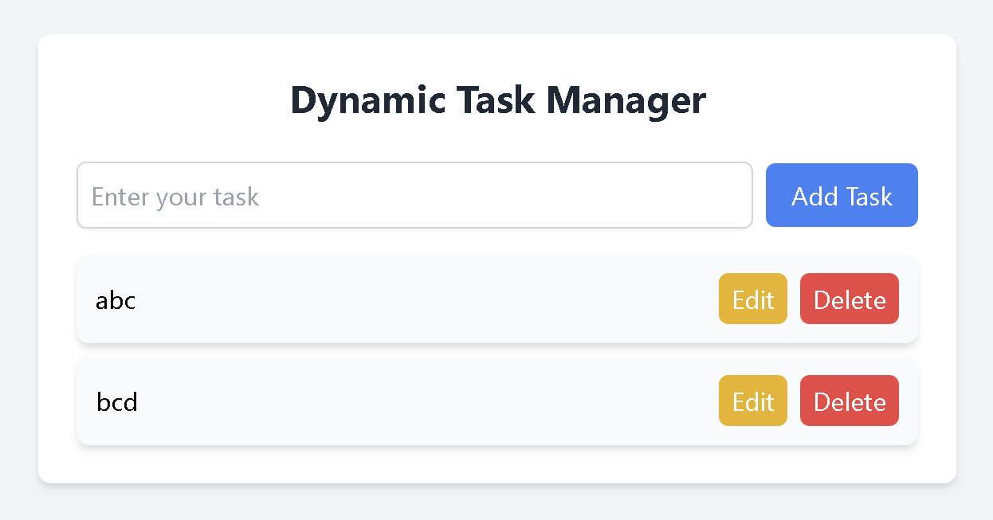
Activity: Dy task mngr

Slide 39
5. Event bubbling in JavaScript
It is a way that events
move through the elements in an HTML document.
When an event happens in a specific element,
it first affects that element and then moves up to its parent elements,
triggering any event listeners attached to those parents.
This process is called “bubbling” because it starts at the bottom
(the innermost element) and bubbles up to the top (the outer elements).

Slide 40
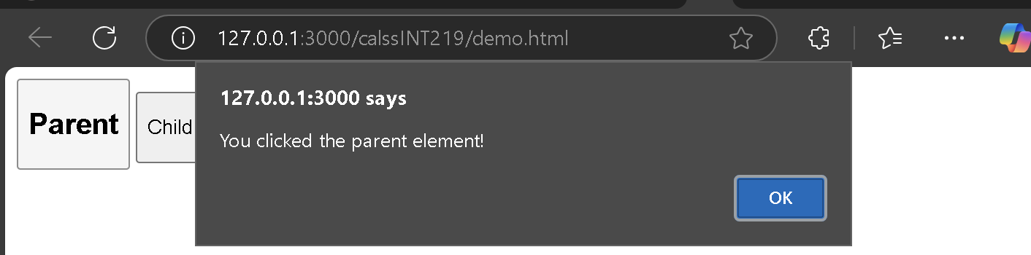
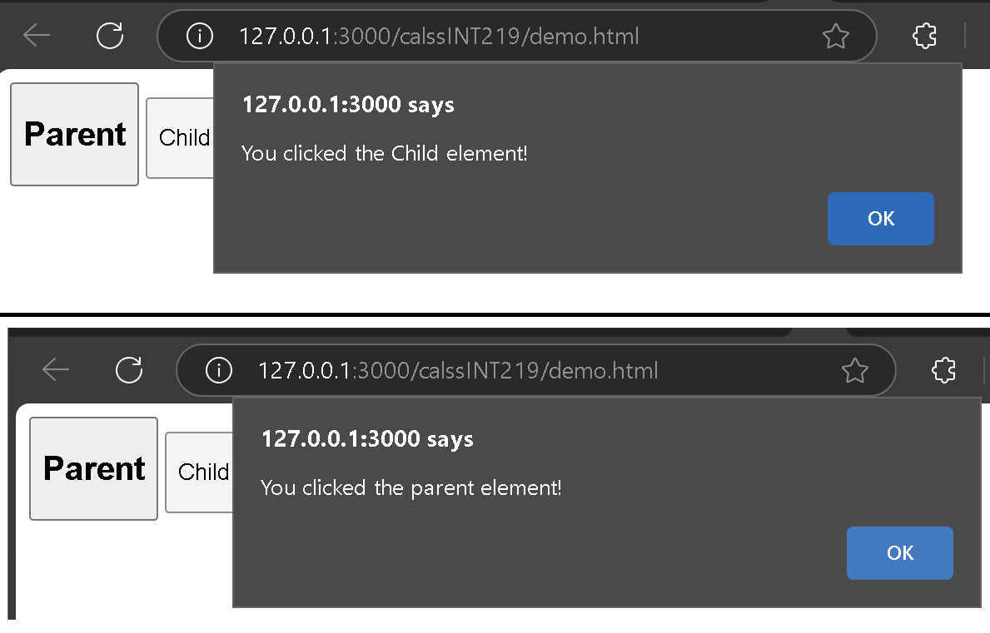
5.1 Event bubbling in JavaScript
<html> <body> <div id="parent">
<button><h2>Parent</h2></button>
<button id="child"> <p>Child</p></button>
</div> <script>
document.getElementById("child").addEventListener
("click", function () { alert("You clicked the Child element!");}, false);
document.getElementById("parent").addEventListener
("click", function () { alert("You clicked the parent element!");}, false);
</script> </body> </html>
When the “Child” button is clicked:
Both the child and parent event listeners are triggered,
Event bubbling causes the event to propagate up the DOM hierarchy.

Slide 41
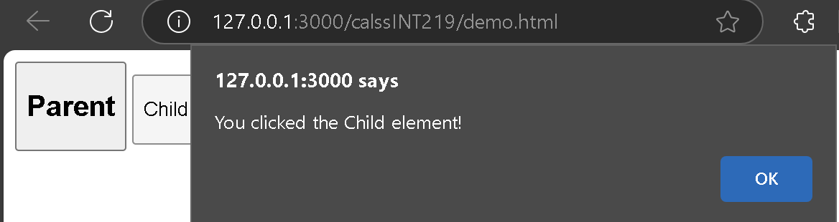
5.2 Event bubbling event.stopPropagation();
<html> <body> <div id="parent">
<button><h2>Parent</h2></button>
<button id="child"> <p>Child</p></button>
</div> <script>
document.getElementById("child").addEventListener
("click", function () { alert("You clicked the Child element!"); event.stopPropagation();}, false);
document.getElementById("parent").addEventListener
("click", function () { alert("You clicked the parent element!");}, false);
</script> </body> </html>
When the “Child” button is clicked:
Both the child and parent event listeners are triggered,
Event bubbling causes the event to propagate up the DOM hierarchy.

Slide 42
How Event Bubbling Works
Starting Point: The event starts with that element. (clicking a button)
Propagation: The event then moves up through its parent elements in the DOM tree, triggering any event listeners that are set up for that event type.
Order of Execution: The innermost element’s event listener is executed first, followed by the outer elements in the order they appear in the DOM.

Slide 43
event.stopPropagation()
<html> <body> <div id="parent">
<button><h2>Parent</h2></button> <button id="child"><p>Child</p></button> </div>
<script>
document.getElementById("child").addEventListener("click", function () {
alert("You clicked the Child element!");event.stopPropagation();}, false);
document.getElementById("parent").addEventListener("click", function () {
alert("You clicked the parent element!");}, false);
</script> </body> </html>

Slide 44
6. Image gallery with thumbnails in JavaScript
<html> <body> <h1>Simple Image Gallery</h1>
<img id="main-image" src="1.jpg" alt="Main Display" width="400">
<div><img class="thumbnail" src="1.jpg" alt="Thumbnail 1" width="80">
<img class="thumbnail" src="2.jpg" alt="Thumbnail 2" width="80"></div>
<script>
const mainImage = document.getElementById("main-image");
const thumbnails = document.querySelectorAll(".thumbnail");
thumbnails.forEach((thumbnail) =>
{thumbnail.addEventListener("click", () => { mainImage.src = thumbnail.src; }); });
</script> </body> </html>

Slide 45
Geolocation API OSM
<style>
body {
font-family: Arial, sans-serif; display: flex;flex-direction: column; align-items: center;
min-height: 100vh; margin: 0; background-color: #f0f0f0;
} .container {
background: white; padding: 2rem; border-radius: 8px; box-shadow: 0 2px 4px rgba(0,0,0,0.1);
margin-top: 2rem; text-align: center;max-width: 500px;
} button {
padding: 10px 20px;background-color: #4CAF50;color: white;border: none;
border-radius: 4px;cursor: pointer;margin: 10px 0;
} button:hover { background-color: #45a049; } #locationInfo {
margin-top: 20px;padding: 10px; border: 1px solid #ddd;border-radius: 4px;display: none;
} .error { color: #ff4444; margin-top: 10px; }
</style>

Slide 46
Div tag
<div class="container">
<h2>Get Your Location</h2>
<button onclick="getLocation()">Find My Location</button>
<div id="locationInfo">
<p>Latitude: <span id="lat"></span></p>
<p>Longitude: <span id="lon"></span></p>
<p>Accuracy: <span id="acc"></span> meters</p>
<p>Address: <span id="address">Loading...</span></p>
</div>
<div id="error" class="error"></div>
</div>

Slide 47
API code
<script>
async function getLocation() {
const locationInfo = document.getElementById('locationInfo');
const errorDiv = document.getElementById('error');
const latSpan = document.getElementById('lat');
const lonSpan = document.getElementById('lon');
const accSpan = document.getElementById('acc');
const addressSpan = document.getElementById('address');
if ("geolocation" in navigator) {
errorDiv.textContent = 'Fetching location...';
try {
// Get position
const position = await new Promise((resolve, reject) => {
navigator.geolocation.getCurrentPosition(resolve, reject, {
enableHighAccuracy: true,
timeout: 5000,
maximumAge: 0
});
});
const latitude = position.coords.latitude;
const longitude = position.coords.longitude;
const accuracy = position.coords.accuracy;
// Update UI with coordinates
latSpan.textContent = latitude.toFixed(6);
lonSpan.textContent = longitude.toFixed(6);
accSpan.textContent = Math.round(accuracy);
locationInfo.style.display = 'block';
errorDiv.textContent = '';
// Fetch address using OpenStreetMap Nominatim API
try {
const response = await fetch(
`https://nominatim.openstreetmap.org/reverse?format=json&lat=${latitude}&lon=${longitude}&zoom=18&addressdetails=1`
);
const data = await response.json();
if (data && data.display_name) {
addressSpan.textContent = data.display_name;
} else {
addressSpan.textContent = 'Address not found';
}
} catch (apiError) {
addressSpan.textContent = 'Error fetching address';
console.error('API Error:', apiError);
}
} catch (error) {
locationInfo.style.display = 'none';
switch(error.code) {
case error.PERMISSION_DENIED:
errorDiv.textContent = "User denied the request for Geolocation.";
break;
case error.POSITION_UNAVAILABLE:
errorDiv.textContent = "Location information is unavailable.";
break;
case error.TIMEOUT:
errorDiv.textContent = "The request to get user location timed out.";
break;
default:
errorDiv.textContent = "An unknown error occurred.";
break;
}
}
} else {
errorDiv.textContent = "Geolocation is not supported by this browser.";
}
}
</script>

Slide 48


